Slide 1
Облачна услуга Microsoft Azure
(Microsoft Azure Cloud Service)

Slide 2
История
Azure is a cloud computing platform which was launched by Microsoft in February 2010. It is an open and flexible cloud platform which helps in development, data storage, service hosting, and service management. The Azure tool hosts web applications over the internet with the help of Microsoft data centers.

Slide 3
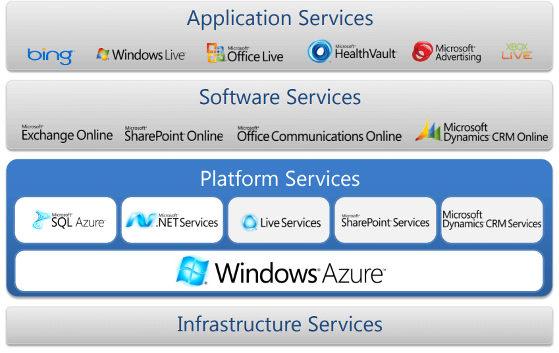
Типове облачни услуги в Azure
Resource Utilization
Remote Workforce Enablement
Security

Slide 4
Azure concepts
Concept Name | Description
Regions | Azure is a global cloud platform which is available across various regions around the world. When you request a service, application, or VM in Azure, you are first asked to specify a region. The selected region represents datacenter where your application runs.
Datacenter | In Azure, you can deploy your applications into a variety of data centers around the globe. So, it is advisable to select a region which is closer to most of your customers. It helps you to reduce latency in network requests.
Azure portal | The Azure portal is a web-based application which can be used to create, manage and remove Azure resource and services. It is located at https://portal.azure.com.

Slide 5
Concepts (Cont.)
Resources | Azure resource is an individual computer, networking data or app hosting services which charged individually. Some common resources are virtual machines( VM), storage account, or SQL databases.
Resource groups | An Azure resource group is a container which holds related resource for an Azure solution. It may include every resource or just resource which you wants to manage.
Resource Manager templates | It is a JSON which defines one or more resource to deploy to a resource group. It also establishes dependencies between deployed resources.
Automation: | Azure allows you to automate the process of creating, managing and deleting resource by using PowerShell or the Azure command-line Interface(CLI).

Slide 6
Concepts (end)
Azure PowerShell | PowerShell is a set of modules that offer cmdlets to manage Azure. In most cases, you are allowed to use, the cmdlets command for the same tasks which you are performing in the Azure portal.
Azure command-line interface(CLI) | The Azure CLI is a tool that you can use to create, manage, and remove Azure resources from the command line.
REST APIs | Azure is built on a set of REST APIs help you perform the same operation that you do in Azure portal Ul. It allows your Azure resources and apps to be manipulated via any third party software application.

Slide 7
Datacenters
Datacenters help connect and empower our daily lives
Hundreds of Azure datacenters store and manage data around the world.
Azure datacenters are unique physical buildings located all over the globe that house a group of networked computer servers, each equipped with independent power, cooling, and networking.

Slide 8
Regions
With more global regions than any other cloud provider, Azure gives customers the flexibility to deploy applications where they need.
A region is a set of datacenters deployed within a latency-defined perimeter and connected through a dedicated regional low-latency network. While solution suites Microsoft 365 and Dynamics 365 deploy in geographies, Azure itself deploys in regions, each with distinct pricing and service availability.

Slide 9
Availability Zones
Availability Zones protect your applications and data from datacenter failures.
Azure Availability Zones, which are made up of a minimum of three zones, allow customers to spread their infrastructure and applications across discrete and dispersed datacenters for added resiliency, high availability, and the confidence that data traversing between Availability Zones is always encrypted.

Slide 10
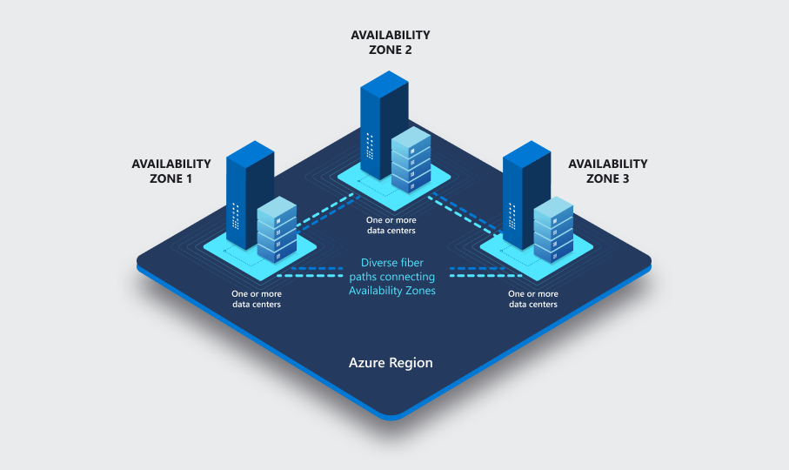
Regions and availability zones

Slide 11
Edge Zones
Extending through Edge Zones means better delivery of latency-sensitive services in densely populated cities.
Edge Zones are small-footprint extensions of Azure placed in population centers that are far from Azure regions. Azure public MEC (multi-access edge compute) integrates Azure compute and services with mobile operator 5G connectivity for low-latency applications at the operator edge.

Slide 12
Geographies
An Azure geography is a distinct market, typically containing one or more regions.
Geographies allow customers with specific data residency (where data is stored and processed) and compliance needs to keep their data and applications close. Through their connection to our dedicated high-capacity networking infrastructure, geographies are fault-tolerant to withstand complete region failure.

Slide 13
Azure regions with AZ
Americas | Europe | Africa | Asia Pacific
Brazil South | France Central | South Africa North | Australia East
Canada Central | Germany West Central |  | Central India
Central US | North Europe |  | Japan East
East US | Norway East |  | Korea Central
East US 2 | UK South |  | Southeast Asia
South Central US | West Europe |  | East Asia
US Gov Virginia | Sweden Central |  | China North 3
West US 2 | Switzerland North*
West US 3

Slide 14
Azure in Europe
Austria
Belgium
Denmark
North Europe (Ireland)
West Europe (Netherlands)
Finland
France
Germany
Greece
Italy
Norway
Poland
Spain
Sweden
Switzerland
United Kingdom

Slide 15
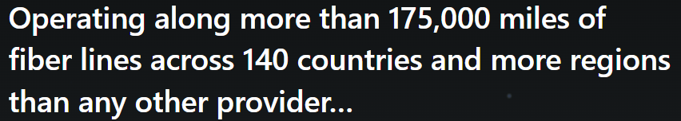
Connections
Network points-of-presence (PoPs) optimize network performance for Azure cloud services.
To route services the fastest way possible, these local access points to and from the vast Microsoft global network typically operate at very fast latency within highly dense economic and population centers.
Azure Orbital ground stations connect satellites to the earth.
Extend the utility of Azure capabilities through the power of space infrastructure.

Slide 16
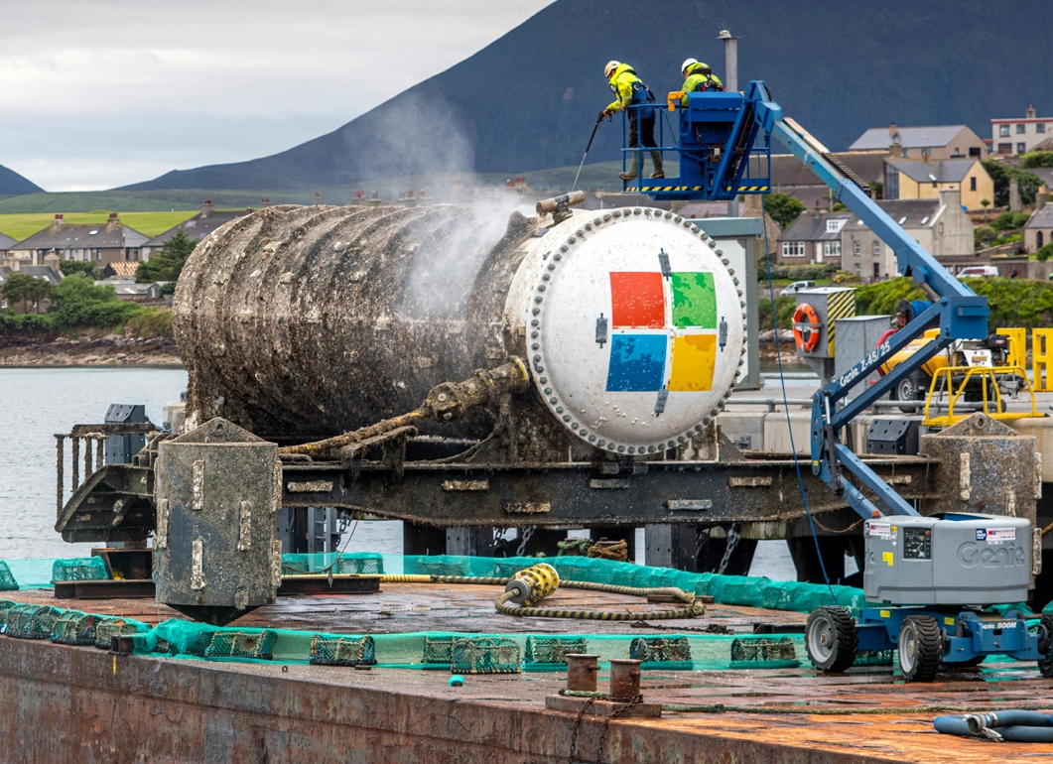
Project Natick

Slide 17
Azure Categories (Domains)
General
Compute
Networking
Storage
Web
Mobile
Containers
Databases
Analytics
AI + machine learning
Internet of things
Mixed reality
Integration
Identity
Security
DevOps
Migration
Monitor
Management and governance
Intune
Hybrid + multicloud
Other

Slide 18
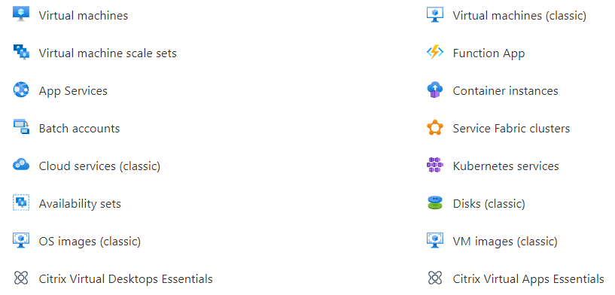
Compute

Slide 19
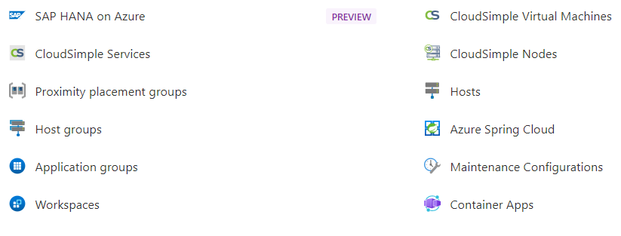
Compute (cont.)

Slide 20
Compute options
Virtual machines are software emulations of physical computers.
Virtual machine scale sets are an Azure compute resource that you can use to deploy and manage a set of identical VMs. With all VMs configured the same, virtual machine scale sets are designed to support true autoscale.

Slide 21
Compute options (cont.)
Containers and Kubernetes - Container Instances and Azure Kubernetes Service are Azure compute resources that you can use to deploy and manage containers.
App Service - With Azure App Service, you can quickly build, deploy, and scale enterprise-grade web, mobile, and API apps running on any platform (PaaS).

Slide 22
Compute options (end)
Functions are ideal when you're concerned only about the code running your service and not the underlying platform or infrastructure. They're commonly used when you need to perform work in response to an event (often via a REST request), timer, or message from another Azure service, and when that work can be completed quickly, within seconds or less.

Slide 23
Azure VM checklist
Start with the network
Name the VM
Decide the location for the VM
Determine the size of the VM
Understanding the pricing model
Storage for the VM
Select an operating system

Slide 24
When to use VMs
VMs are an ideal choice when you need:
Total control over the operating system (OS).
The ability to run custom software.
To use custom hosting configurations.
Scenarios for VM use:
During testing and development.
When running applications in the cloud.
When extending your datacenter to the cloud
During disaster recovery.

Slide 25
Azure Batch
Azure Batch enables large-scale parallel and high-performance computing (HPC) batch jobs with the ability to scale to tens, hundreds, or thousands of VMs.
When you're ready to run a job, Batch does the following:
Starts a pool of compute VMs for you.
Installs applications and staging data.
Runs jobs with as many tasks as you have.
Identifies failures.
Requeues work.
Scales down the pool as work completes.

Slide 26
when to use Azure App Service
App Service enables you to build and host web apps, background jobs, mobile back-ends, and RESTful APIs in the programming language of your choice without managing infrastructure. It offers automatic scaling and high availability. App Service supports Windows and Linux and enables automated deployments from GitHub, Azure DevOps, or any Git repo to support a continuous deployment model.
With App Service, you can host most common app service styles like:
Web apps - ASP.NET, Java, Ruby, Node.js, PHP, Python.
API apps - REST-based web APIs.
WebJobs - run a program (.exe, Java, PHP, Python, or Node.js) or script (.cmd, .bat, PowerShell, or Bash)
Mobile apps - iOS and Android.

Slide 27
Manage containers
Azure Container Instances offers the fastest and simplest way to run a container in Azure without having to manage any virtual machines or adopt any additional services. It's a platform as a service (PaaS) offering that allows you to upload your containers, which it runs for you.
The task of automating, managing, and interacting with a large number of containers is known as orchestration. Azure Kubernetes Service is a complete orchestration service for containers with distributed architectures and large volumes of containers.

Slide 28
when to use Azure Functions
Serverless computing is the abstraction of servers, infrastructure, and operating systems. With serverless computing, Azure takes care of managing the server infrastructure and the allocation and deallocation of resources based on demand. Infrastructure isn't your responsibility. Scaling and performance are handled automatically. You're billed only for the exact resources you use. There's no need to even reserve capacity.
To reduce your costs, you want to avoid having to pay for the time that your application is waiting for input. With that in mind, you've decided to investigate Azure Functions to see if it can help.

Slide 29
Serverless computing includes:
Abstraction of servers: Serverless computing abstracts the servers you run on. You never explicitly reserve server instances. The platform manages that for you. Each function execution can run on a different compute instance. This execution context is transparent to the code. With serverless architecture, you deploy your code, which then runs with high availability.
Event-driven scale: Serverless computing is an excellent fit for workloads that respond to incoming events. Events include triggers by:
Timers, for example, if a function needs to run every day at 10:00 AM
HTTP, for example, API and webhook scenarios.
Queues, for example, with order processing.
Micro-billing: Traditional computing bills for a block of time like paying a monthly or annual rate for website hosting. This method of billing is convenient but isn't always cost effective. Even if a customer's website gets only one hit a day, they still pay for a full day's worth of availability. With serverless computing, they pay only for the time their code runs. If no active function executions occur, they're not charged.

Slide 30
Azure has two implementations of serverless compute
Azure Functions: Functions can execute code in almost any modern language.
Azure Logic Apps: Logic apps are designed in a web-based designer and can execute logic triggered by Azure services without writing any code.
With Functions, you write code to complete each step.
With Logic Apps, you use a GUI to define the actions and how they relate to one another.

Slide 31
Azure Virtual Desktop
Azure Virtual Desktop is a desktop and application virtualization service that runs on the cloud. It enables your users to use a cloud-hosted version of Windows from any location. Azure Virtual Desktop works across devices like Windows, Mac, iOS, Android, and Linux. It works with apps that you can use to access remote desktops and apps. You can also use most modern browsers to access Azure Virtual Desktop-hosted experiences

Slide 32
Storage
a service that you can use to store files, messages, tables, and other types of information.
Clients such as websites, mobile apps, desktop applications, and many other types of custom solutions can read data from and write data to Azure Storage. Azure Storage is also used by infrastructure as a service virtual machines, and platform as a service cloud services.
To begin using Azure Storage, you first create an Azure Storage account to store your data objects. You can create an Azure Storage account by using the Azure portal, PowerShell, or the Azure CLI.

Slide 33
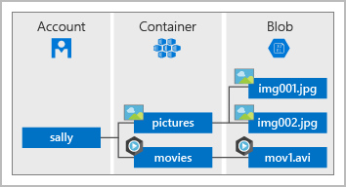
Storage Account
Your storage account will contain all of your Azure Storage data objects, such as blobs, files, and disks.

Slide 34
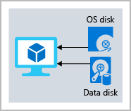
Disk storage fundamentals
Disk Storage provides disks for Azure virtual machines. Applications and other services can access and use these disks as needed, similar to how they would in on-premises scenarios. Disk Storage allows data to be persistently stored and accessed from an attached virtual hard disk.

Slide 35
Azure Blob storage fundamentals
Azure Blob Storage is an object storage solution for the cloud. It can store massive amounts of data, such as text or binary data. Azure Blob Storage is unstructured, meaning that there are no restrictions on the kinds of data it can hold. Blob Storage can manage thousands of simultaneous uploads, massive amounts of video data, constantly growing log files, and can be reached from anywhere with an internet connection.

Slide 36
Blob Storage is ideal for:
Serving images or documents directly to a browser.
Storing files for distributed access.
Streaming video and audio.
Storing data for backup and restore, disaster recovery, and archiving.
Storing data for analysis by an on-premises or Azure-hosted service.
Storing up to 8 TB of data for virtual machines.
You store blobs in containers, which helps you organize your blobs depending on your business needs.

Slide 37
Azure Files fundamentals
Azure Files offers fully managed file shares in the cloud that are accessible via the industry standard Server Message Block and Network File System (preview) protocols. Azure file shares can be mounted concurrently by cloud or on-premises deployments of Windows, Linux, and macOS. Applications running in Azure virtual machines or cloud services can mount a file storage share to access file data, just as a desktop application would mount a typical SMB share. Any number of Azure virtual machines or roles can mount and access the file storage share simultaneously. Typical usage scenarios would be to share files anywhere in the world, diagnostic data, or application data sharing.

Slide 38
Use Azure Files for the following
Many on-premises applications use file shares. Azure Files makes it easier to migrate those applications that share data to Azure. If you mount the Azure file share to the same drive letter that the on-premises application uses, the part of your application that accesses the file share should work with minimal changes, if any.
Store configuration files on a file share and access them from multiple VMs. Tools and utilities used by multiple developers in a group can be stored on a file share, ensuring that everybody can find them, and that they use the same version.
Write data to a file share, and process or analyze the data later. For example, you might want to do this with diagnostic logs, metrics, and crash dumps.

Slide 39
Understand Blob access tiers
Azure Storage offers different access tiers for your blob storage, helping you store object data in the most cost-effective manner. The available access tiers include:
Hot access tier: Optimized for storing data that is accessed frequently (for example, images for your website).
Cool access tier: Optimized for data that is infrequently accessed and stored for at least 30 days (for example, invoices for your customers).
Archive access tier: Appropriate for data that is rarely accessed and stored for at least 180 days, with flexible latency requirements (for example, long-term backups).

Slide 40
Considerations to the access tiers
Only the hot and cool access tiers can be set at the account level. The archive access tier isn't available at the account level.
Hot, cool, and archive tiers can be set at the blob level, during upload or after upload.
Data in the cool access tier can tolerate slightly lower availability, but still requires high durability, retrieval latency, and throughput characteristics similar to hot data. For cool data, a slightly lower availability service-level agreement (SLA) and higher access costs compared to hot data are acceptable trade-offs for lower storage costs.
Archive storage stores data offline and offers the lowest storage costs, but also the highest costs to rehydrate and access data.

Slide 41
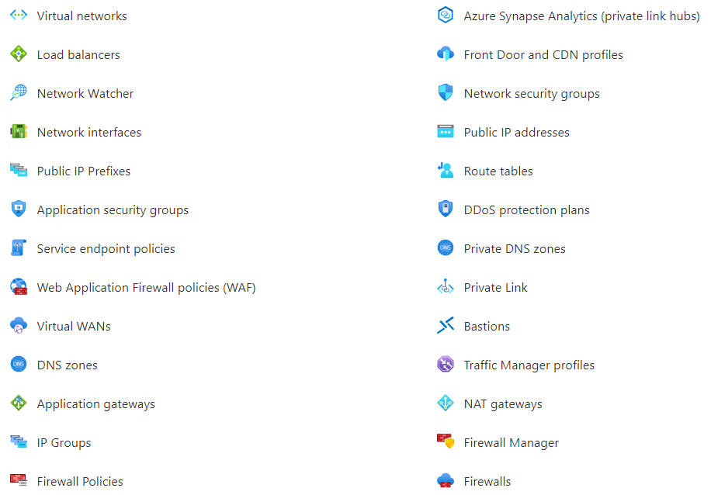
Networking

Slide 42
Azure virtual networking
Isolation and segmentation
Internet communications
Communicate between Azure resources
Communicate with on-premises resources
Route network traffic
Filter network traffic
Connect virtual networks

Slide 43
Isolation and segmentation
Azure virtual network allows you to create multiple isolated virtual networks. When you set up a virtual network, you define a private IP address space by using either public or private IP address ranges. The public IP range only exists within the virtual network and isn't internet routable. You can divide that IP address space into subnets and allocate part of the defined address space to each named subnet.
For name resolution, you can use the name resolution service that's built in to Azure. You can also configure the virtual network to use an internal or an external DNS server.

Slide 44
Internet communications
A VM in Azure can connect to the internet by default. You can enable incoming connections from the internet by assigning a public IP address to the VM or by putting the VM behind a public load balancer. For VM management, you can connect via the Azure CLI, Remote Desktop Protocol, or Secure Shell.

Slide 45
Communicate between Azure resources
Virtual networks. Virtual networks can connect not only VMs but other Azure resources, such as the App Service Environment for Power Apps, Azure Kubernetes Service, and Azure virtual machine scale sets.
Service endpoints. You can use service endpoints to connect to other Azure resource types, such as Azure SQL databases and storage accounts. This approach enables you to link multiple Azure resources to virtual networks to improve security and provide optimal routing between resources.

Slide 46
Communicate with on-premises resources
Point-to-site virtual private networks. The typical approach to a virtual private network (VPN) connection is from a computer outside your organization, back into your corporate network. In this case, the client computer initiates an encrypted VPN connection to connect that computer to the Azure VN.
Site-to-site virtual private networks. A site-to-site VPN links your on-premises VPN device or gateway to the Azure VPN gateway in a virtual network. In effect, the devices in Azure can appear as being on the local network. The connection is encrypted and works over the internet.
Azure ExpressRoute. For environments where you need greater bandwidth and even higher levels of security, Azure ExpressRoute is the best approach. ExpressRoute provides a dedicated private connectivity to Azure that doesn't travel over the internet.

Slide 47
Route network traffic
By default, Azure routes traffic between subnets on any connected virtual networks, on-premises networks, and the internet. You can also control routing and override those settings, as follows:
Route tables. A route table allows you to define rules about how traffic should be directed. You can create custom route tables that control how packets are routed between subnets.
Border Gateway Protocol. Border Gateway Protocol (BGP) works with Azure VPN gateways, Azure Route Server, or ExpressRoute to propagate on-premises BGP routes to Azure virtual networks.

Slide 48
Filter network traffic
Network security groups. A network security group is an Azure resource that can contain multiple inbound and outbound security rules. You can define these rules to allow or block traffic, based on factors such as source and destination IP address, port, and protocol.
Network virtual appliances. A network virtual appliance is a specialized VM that can be compared to a hardened network appliance. A network virtual appliance carries out a particular network function, such as running a firewall or performing wide area network (WAN) optimization.

Slide 49
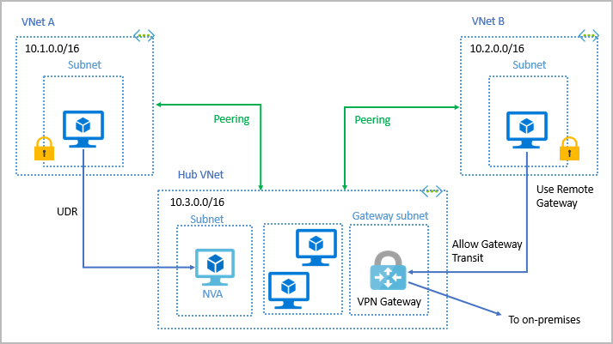
Connecting Vnet’s
UDR - User-defined routes

Slide 50
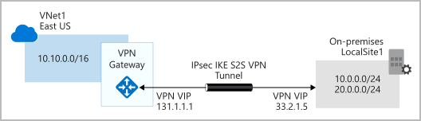
VPN gateways
Connect on-premises datacenters to virtual networks through a site-to-site connection.
Connect individual devices to virtual networks through a point-to-site connection.
Connect virtual networks to other virtual networks through a network-to-network connection.

Slide 51
Policy-based VPN GW
specify statically the IP address of packets that should be encrypted through each tunnel.
Support for IKEv1 only.
Use of static routing, where combinations of address prefixes from both networks control how traffic is encrypted and decrypted through the VPN tunnel.
Policy-based VPNs must be used in specific scenarios that require them, such as for compatibility with legacy on-premises VPN devices.

Slide 52
Route-based VPNs
Use a route-based VPN gateway if you need any of the following types of connectivity:
Connections between virtual networks
Point-to-site connections
Multisite connections
Coexistence with an Azure ExpressRoute gateway
Key features of route-based VPN gateways in Azure include:
Supports IKEv2
Uses any-to-any (wildcard) traffic selectors
Can use dynamic routing protocols (BGP)

Slide 53
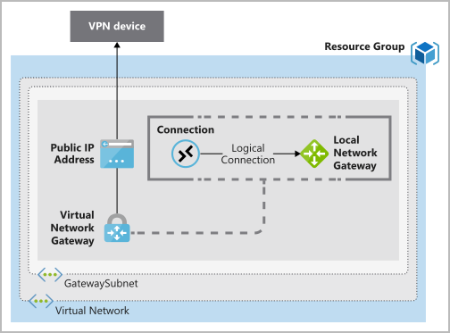
Deploy VPN gateways

Slide 54
Required resources
Virtual network
Gateway Subnet
Public IP address
Local network gateway
Virtual network gateway
Connection

Slide 55
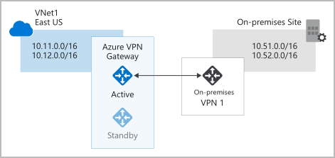
High-availability Active/standby

Slide 56
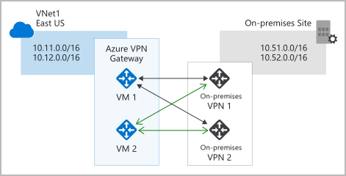
Active/active

Slide 57
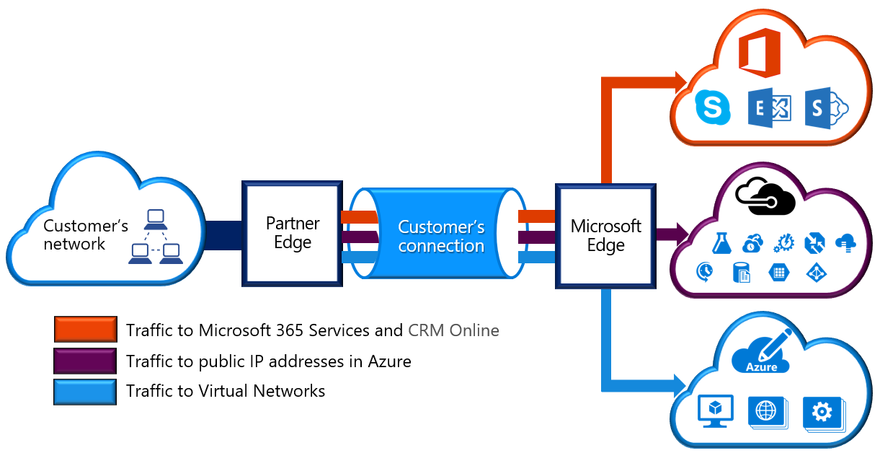
Azure ExpressRoute
ExpressRoute lets you extend your on-premises networks into the Microsoft cloud over a private connection with the help of a connectivity provider.

Slide 58
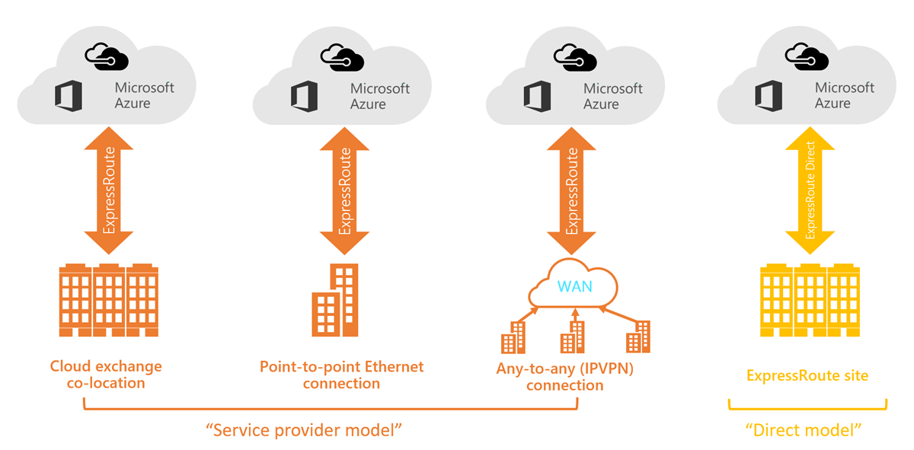
ExpressRoute connectivity models

Slide 59
Azure database and analytics
Azure Cosmos DB
Azure SQL Database
Azure SQL Managed Instance
Azure Database for MySQL
Azure Database for PostgreSQL
Azure Synapse Analytics
Azure HDInsight
Azure Databricks
Azure Data Lake Analytics

Slide 60
Azure Cosmos DB
Azure Cosmos DB is a globally distributed, multi-model database service. You can elastically and independently scale throughput and storage across any number of Azure regions worldwide. You can take advantage of fast, single-digit-millisecond data access by using any one of several popular APIs. Azure Cosmos DB provides comprehensive service level agreements for throughput, latency, availability, and consistency guarantees.
Azure Cosmos DB supports schema-less data, which lets you build highly responsive and "Always On" applications to support constantly changing data. You can use this feature to store data that's updated and maintained by users around the world.

Slide 61
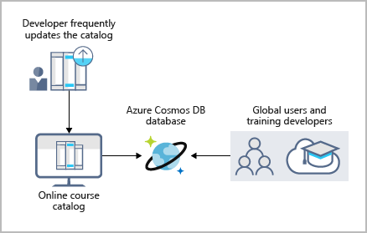
Azure Cosmos DB
Azure Cosmos DB is flexible. At the lowest level, Azure Cosmos DB stores data in atom-record-sequence (ARS) format. The data is then abstracted and projected as an API, which you specify when you're creating your database. Your choices include SQL, MongoDB, Cassandra, Tables, and Gremlin. This level of flexibility means that as you migrate your company's databases to Azure Cosmos DB, your developers can stick with the API that they're the most comfortable with.

Slide 62
Azure SQL Database
Azure SQL Database is a relational database based on the latest stable version of the Microsoft SQL Server database engine. SQL Database is a high-performance, reliable, fully managed, and secure database. You can use it to build data-driven applications and websites in the programming language of your choice, without needing to manage infrastructure.
Azure SQL Database is a platform as a service (PaaS)

Slide 63
Azure database for MySQL
Azure Database for MySQL is a relational database service in the cloud, and it's based on the MySQL Community Edition database engine, versions 5.6, 5.7, and 8.0. With it, you have a 99.99 percent availability service level agreement from Azure.
With Azure Database for MySQL, you can use point-in-time restore to recover a server to an earlier state, as far back as 35 days.
Built-in high availability with no additional cost.
Predictable performance and inclusive, pay-as-you-go pricing.
Scale as needed, within seconds.
Ability to protect sensitive data at-rest and in-motion.
Automatic backups.
Enterprise-grade security and compliance.

Slide 64
Azure Database for PostgreSQL
Azure Database for PostgreSQL is a relational database service in the cloud. The server software is based on the community version of the open-source PostgreSQL database engine.
Built-in high availability compared to on-premises resources. There's no additional configuration, replication, or cost required to make sure your applications are always available.
Simple and flexible pricing. You have predictable performance based on a selected pricing tier choice that includes software patching, automatic backups, monitoring, and security.
Scale up or down as needed, within seconds. You can scale compute or storage independently as needed, to make sure you adapt your service to match usage.
Adjustable automatic backups and point-in-time-restore for up to 35 days.
Enterprise-grade security and compliance to protect sensitive data at-rest and in-motion. This security covers data encryption on disk and SSL encryption between client and server communication.

Slide 65
Azure SQL Managed Instance
Azure SQL Managed Instance is a scalable cloud data service that provides the broadest SQL Server database engine compatibility with all the benefits of a fully managed platform as a service. Depending on your scenario, Azure SQL Managed Instance might offer more options for your database needs.
Azure SQL Managed Instance provides several options that might not be available to Azure SQL Database.
i.e. if using Cyrillic characters for collation, you should migrate their databases to an Azure SQL Managed Instance, since Azure SQL Database only uses the default SQL_Latin1_General_CP1_CI_AS server collation.

Slide 66
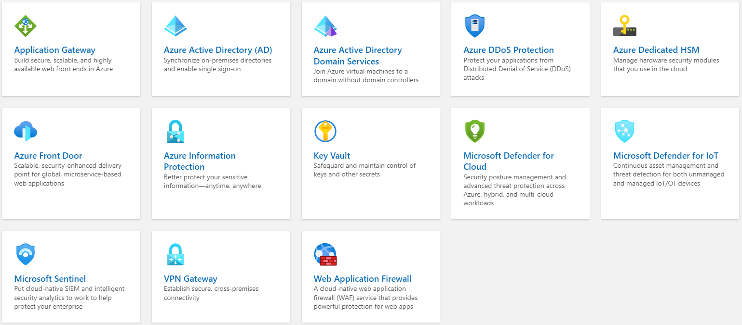
Security

Slide 67
Azure Application Gateway
Azure Application Gateway is a web traffic load balancer that enables you to manage traffic to your web applications. Traditional load balancers operate at the transport layer (OSI layer 4 - TCP and UDP) and route traffic based on source IP address and port, to a destination IP address and port.
Application Gateway can make routing decisions based on additional attributes of an HTTP request, for example URI path or host headers. For example, you can route traffic based on the incoming URL. So if /images is in the incoming URL, you can route traffic to a specific set of servers (known as a pool) configured for images. If /video is in the URL, that traffic is routed to another pool that's optimized for videos.

Slide 68
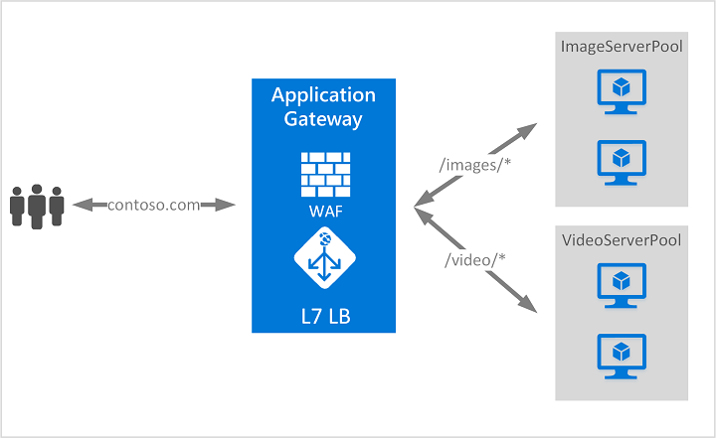
Example

Slide 69
Features
Secure Sockets Layer (SSL/TLS) termination
Autoscaling
Zone redundancy
Web Application Firewall
URL-based routing
Multiple-site hosting
Websocket and HTTP/2 traffic
Connection draining - graceful removal of backend pool members during planned service updates.
Custom error pages
Rewrite HTTP headers and URL

Slide 70
Azure Active Directory
Azure Active Directory (Azure AD) is a cloud-based identity and access management service. This service helps your employees access external resources, such as Microsoft 365, the Azure portal, and thousands of other SaaS applications. Azure Active Directory also helps them access internal resources like apps on your corporate intranet network, along with any cloud apps developed for your own organization.

Slide 71
Who uses Azure AD
IT admins: As an IT admin, use Azure AD to control access to your apps and your app resources, based on your business requirements.
App developers: As an app developer, you can use Azure AD as a standards-based approach for adding single sign-on (SSO) to your app, allowing it to work with a user's pre-existing credentials.
Microsoft 365, Office 365, Azure, or Dynamics CRM Online subscribers: As a subscriber, you're already using Azure AD. Each Microsoft 365, Office 365, Azure, and Dynamics CRM Online tenant is automatically an Azure AD tenant.

Slide 72
Azure AD licenses
Azure Active Directory Free. Provides user and group management, on-premises directory synchronization, basic reports, self-service password change for cloud users, and SSO across Azure, Microsoft 365, and other SaaS apps.
Azure Active Directory Premium P1. Lets your hybrid users access both on-premises and cloud resources. It also supports advanced administration, such as dynamic groups, self-service group management, Microsoft Identity Manager, and others.
Azure Active Directory Premium P2. Offers Azure Active Directory Identity Protection to help provide risk-based Conditional Access to your apps and critical company data and Privileged Identity Management to help discover, restrict, and monitor administrators and their access to resources and to provide just-in-time access when needed.

Slide 73
Azure AD Domain Services
Azure Active Directory Domain Services (Azure AD DS) provides managed domain services such as domain join, group policy, lightweight directory access protocol (LDAP), and Kerberos/NTLM authentication. You use these domain services without the need to deploy, manage, and patch domain controllers (DCs) in the cloud.

Slide 74
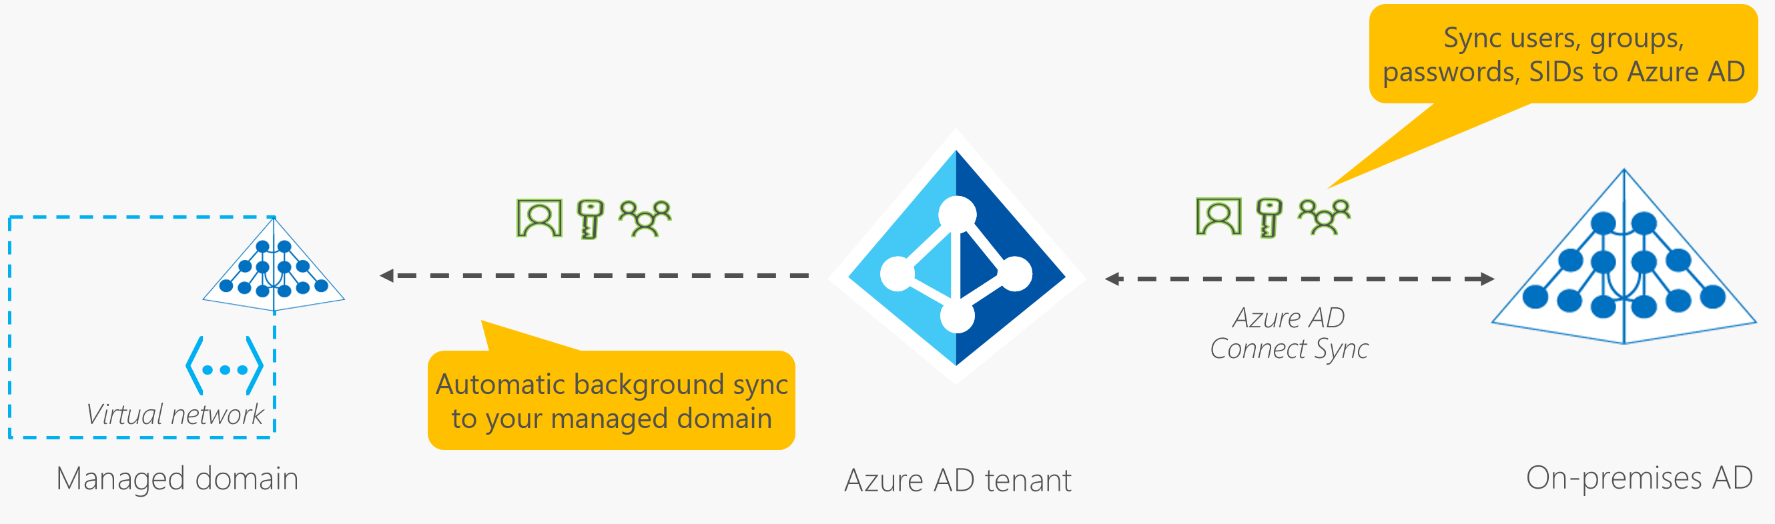
How does Azure AD DS work

Slide 75
Azure AD DS features and benefits
Simplified deployment experience: Azure AD DS is enabled for your Azure AD tenant using a single wizard in the Azure portal.
Integrated with Azure AD: User accounts, group memberships, and credentials are automatically available from your Azure AD tenant.
Accounts in external directories linked to your Azure AD aren't available in Azure AD DS.
Use your corporate credentials/passwords.
NTLM and Kerberos authentication: you can deploy applications that rely on Windows-integrated authentication.
High availability: Azure AD DS includes multiple domain controllers, which provide high availability for your managed domain. This high availability guarantees service uptime and resilience to failures.

Slide 76
Azure DDoS Protection
Azure DDoS Protection Standard, combined with application design best practices, provides enhanced DDoS mitigation features to defend against DDoS attacks. It is automatically tuned to help protect your specific Azure resources in a virtual network. Protection is simple to enable on any new or existing virtual network, and it requires no application or resource changes.

Slide 77
Features
Native platform integration: Natively integrated into Azure.
Turnkey protection: Simplified configuration immediately protects all resources on a virtual network
Always-on traffic monitoring: Your application traffic patterns are monitored 24 hours a day, 7 days a week, looking for indicators of DDoS attacks. DDoS Protection Standard instantly and automatically mitigates the attack, once it is detected.

Slide 78
Features - 2
Adaptive tuning: Intelligent traffic profiling learns your application's traffic over time, and selects and updates the profile that is the most suitable for your service.
Extensive mitigation scale: Over 60 different attack types can be mitigated
Attack analytics: Get detailed reports in five-minute increments during an attack, and a complete summary after the attack ends.

Slide 79
Features - 3
Attack metrics: Summarized metrics from each attack are accessible through Azure Monitor.
Attack alerting: Alerts can be configured at the start and stop of an attack, and over the attack's duration, using built-in attack metrics.
DDoS Rapid Response

Slide 80
Pricing
DDoS protection plans have a fixed monthly charge of $2,944 per month which covers up to 100 public IP addresses. Protection for additional resources will cost an additional $30 per resource per month.
Under a tenant, a single DDoS protection plan can be used across multiple subscriptions, so there is no need to create more than one DDoS protection plan.

Slide 81
Azure Dedicated HSM
Azure Dedicated HSM is an Azure service that provides cryptographic key storage in Azure. Dedicated HSM meets the most stringent security requirements
HSM devices are deployed globally across several Azure regions. They can be easily provisioned as a pair of devices and configured for high availability. HSM devices can also be provisioned across regions to assure against regional-level failover.

Slide 82
Best fit
Azure Dedicated HSM is most suitable for “lift-and-shift” scenarios that require direct and sole access to HSM devices. Examples include:
Migrating applications from on-premises to Azure Virtual Machines
Migrating applications from Amazon AWS EC2 to virtual machines that use the AWS Cloud HSM Classic service (Amazon is not offering this service to new customers)
Running shrink-wrapped software such as Apache/Ngnix SSL Offload, Oracle TDE, and ADCS in Azure Virtual Machines

Slide 83
Not a fit
Azure Dedicated HSM is not a good fit for the following type of scenario: Microsoft cloud services that support encryption with customer-managed keys (such as Azure Information Protection, Azure Disk Encryption, Azure Data Lake Store, Azure Storage, Azure SQL Database, and Customer Key for Office 365) that are not integrated with Azure Dedicated HSM.

Slide 84
Azure Front Door
Whether you’re delivering content and files or building global apps and APIs, Azure Front Door can help you deliver higher availability, lower latency, greater scale, and more secure experiences to your users.
Azure Front Door is Microsoft’s modern cloud Content Delivery Network (CDN) that provides fast, reliable, and secure access between your users and your applications’ static and dynamic web content across the globe. Azure Front Door delivers your content using the Microsoft’s global edge network with hundreds of global and local POPs distributed around the world close to both your enterprise and consumer end users.

Slide 85
Azure Information Protection (AIP)
Azure Information Protection (AIP) is a cloud-based solution that enables organizations to discover, classify, and protect documents and emails by applying labels to content.
AIP is part of the Microsoft Information Protection (MIP) solution, and extends the labeling and classification functionality provided by Microsoft 365.

Slide 86
Azure Key Vault
Azure Key Vault helps solve the following problems:
Secrets Management - Azure Key Vault can be used to Securely store and tightly control access to tokens, passwords, certificates, API keys, and other secrets
Key Management - Azure Key Vault can be used as a Key Management solution. It makes it easy to create and control the encryption keys used to encrypt your data.
Azure Key Vault has two service tiers: Standard, which encrypts with a software key, and a Premium tier, which includes hardware security module(HSM)-protected keys.
Certificate Management - Azure Key Vault lets you easily provision, manage, and deploy public and private Transport Layer Security/Secure Sockets Layer (TLS/SSL) certificates for use with Azure and your internal connected resources.

Slide 87
Microsoft Defender for Cloud
Defender for Cloud is a tool for security posture management and threat protection. It strengthens the security posture of your cloud resources, and with its integrated Microsoft Defender plans, Defender for Cloud protects workloads running in Azure, hybrid, and other cloud platforms.
Defender for Cloud provides the tools needed to harden your resources, track your security posture, protect against cyber attacks, and streamline security management. Because it's natively integrated, deployment of Defender for Cloud is easy, providing you with simple auto provisioning to secure your resources by default.

Slide 88
Microsoft Defender for IoT
Microsoft Defender for IoT is a unified security solution for identifying IoT and OT devices, vulnerabilities, and threats and managing them through a central interface. This set of documentation describes how end-user organizations can secure their entire IoT/OT environment, including protecting existing devices or building security into new IoT innovations.

Slide 89
Microsoft Sentinel
Microsoft Sentinel is a scalable, cloud-native, security information and event management (SIEM) and security orchestration, automation, and response (SOAR) solution. Microsoft Sentinel delivers intelligent security analytics and threat intelligence across the enterprise, providing a single solution for attack detection, threat visibility, proactive hunting, and threat response.

Slide 90
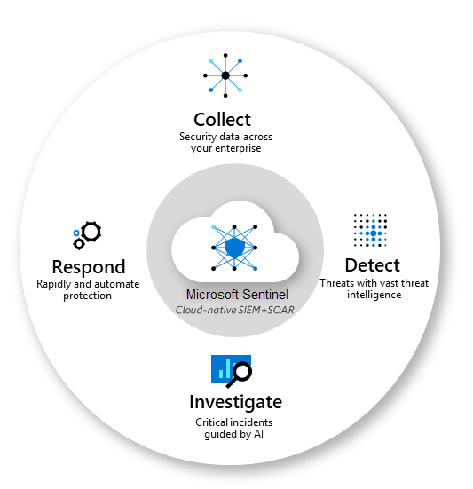

Slide 91
VPN Gateway
VPN Gateway sends encrypted traffic between an Azure virtual network and an on-premises location over the public Internet. You can also use VPN Gateway to send encrypted traffic between Azure virtual networks over the Microsoft network. A VPN gateway is a specific type of virtual network gateway. Each virtual network can have only one VPN gateway. However, you can create multiple connections to the same VPN gateway. When you create multiple connections to the same VPN gateway, all VPN tunnels share the available gateway bandwidth.

Slide 92
Web Application Firewall
Web Application Firewall (WAF) provides centralized protection of your web applications from common exploits and vulnerabilities. Web applications are increasingly targeted by malicious attacks that exploit commonly known vulnerabilities. SQL injection and cross-site scripting are among the most common attacks.

Slide 93
